Slide 1
Adaptive Error Mitigation Framework for Quantum Circuits
QAMP 2025
Github Issue # 15
Github Repo link.
Kurian
Shreyansh
Aashay
Dikshant
Notes:
Hello Everyone,
This group 15 of the QAMP 2025. Our project explored Adaptive Error mitigation framework for quantum circuits. In this presentation I give you guys an overview of our work for the past 3 months.

Slide 2
Content
1
Problem Statement
2
Adaptive Estimator Framework
3
TREX
4
Dynamical Decoupling
5
Zero Noise Extrapolation
6
Results

Slide 3
Problem Statement
Error mitigation is essential for better results in the Noisy Intermediate-Scale Quantum (NISQ) era.
Existing mitigation techniques target specific noise types and lack a single, generalized effectiveness.
Users currently need prior knowledge to select and assess the benefit of a method for a given circuit.
Goal : A framework that dynamically selects optimal Error Mitigation and Suppression Techniques.
Notes:
So we all know error mitigation techniques are essential for extracting better results from device and they have proven to be integral part of our workflow in NISQ devices.
EMs tend to reduce noise and each error mitigation technique is tailored towards certain device errors. Using the EMs through EstimatorOptions although selecting EMTech for your problem is difficult due to the hardness in estimating device noise with respect to the circuit/problem.
Therefore our idea is to build a framework that dynamically selects EMSTs based on the backend noise and the circuit properties. A crucial point to note here applying an particular EM blindly does not guarantee an improvement in results.

Slide 4
Adaptive Estimator Framework
A transparent wrapper to Estimator automatically configuring EstimatorOptions based on heuristics.
AdaptiveEstimator
BackendProperties
Circuit Analysis Engine
Estimator
Transpiled Quantum Circuit or PUBs
EstimatorOptions
Heuristics Decision Engine
Notes:
Currently the workflow for the module looks like this…
Let's take an PUB or circuit which is to be run using the Estimator primitive. To do this we have set the PUBs and provide EM configuration through the EstimatorOptions. In our framework we use the backend properties of the hardware along with the some circuit properties that we extract using the circuit analysis engine, calculate pre-defined heuristics and based on the results configure EstimatorOptions.
The adaptive Estimator is built as a transparent wrapper to Estimator class and the Circuit analysis engine and heuristics are just help in the configuration.

Slide 5
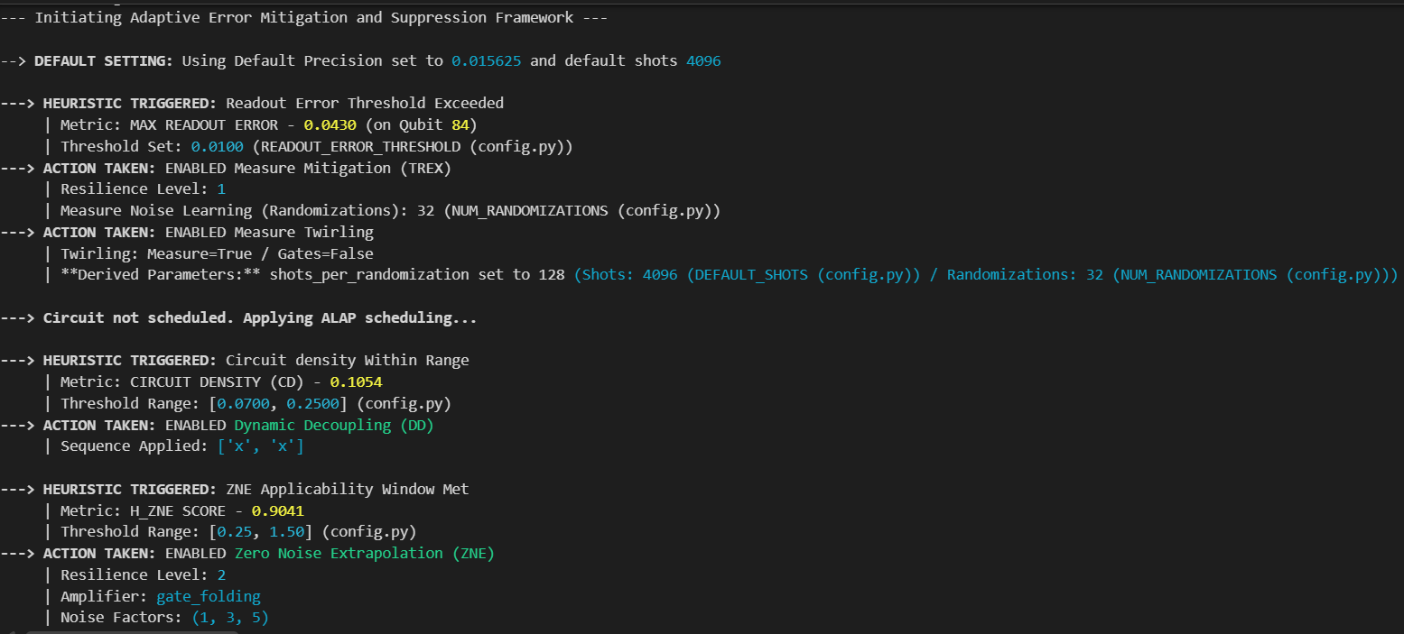
Usage
from adaptive_error_mitigation import adaptive_estimator
adapt_results = adaptive_estimator.run(pubs, backend=backend)
Notes:
Since this is a wrapper we have kept the syntax easy and similar to the Estimator primitive. Once you run the primitive you first receive a datastring in which the framework describes the the heuristics triggered and mentions their values. It also shows the threshold values that we use to decide the applicability of a heuristic. These are stored in a config.py files and can be changed by user in case of drifts in the device noise.

Slide 6


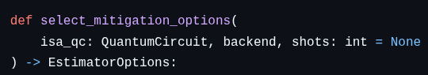
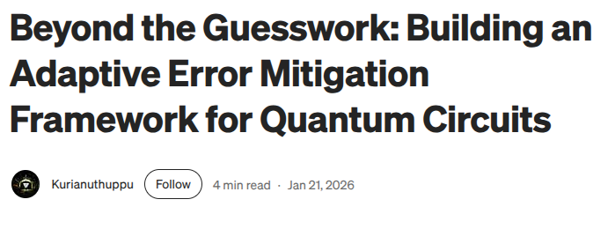
Deliverables
Circuit Analysis Engine.
Adaptive Estimator Integration
Documentation and Blog Publication
Notes:
So as part of the deliverables we have built a circuit analysis engine and heuristic selector. So these functions () help in extracting the circuit and hardware noise parameters.
As the heuristic engine we have built the select_mitigation_options.
We have tutorials on the using our package in the github repo and we have also published a blog on medium regarding our work.

Slide 7
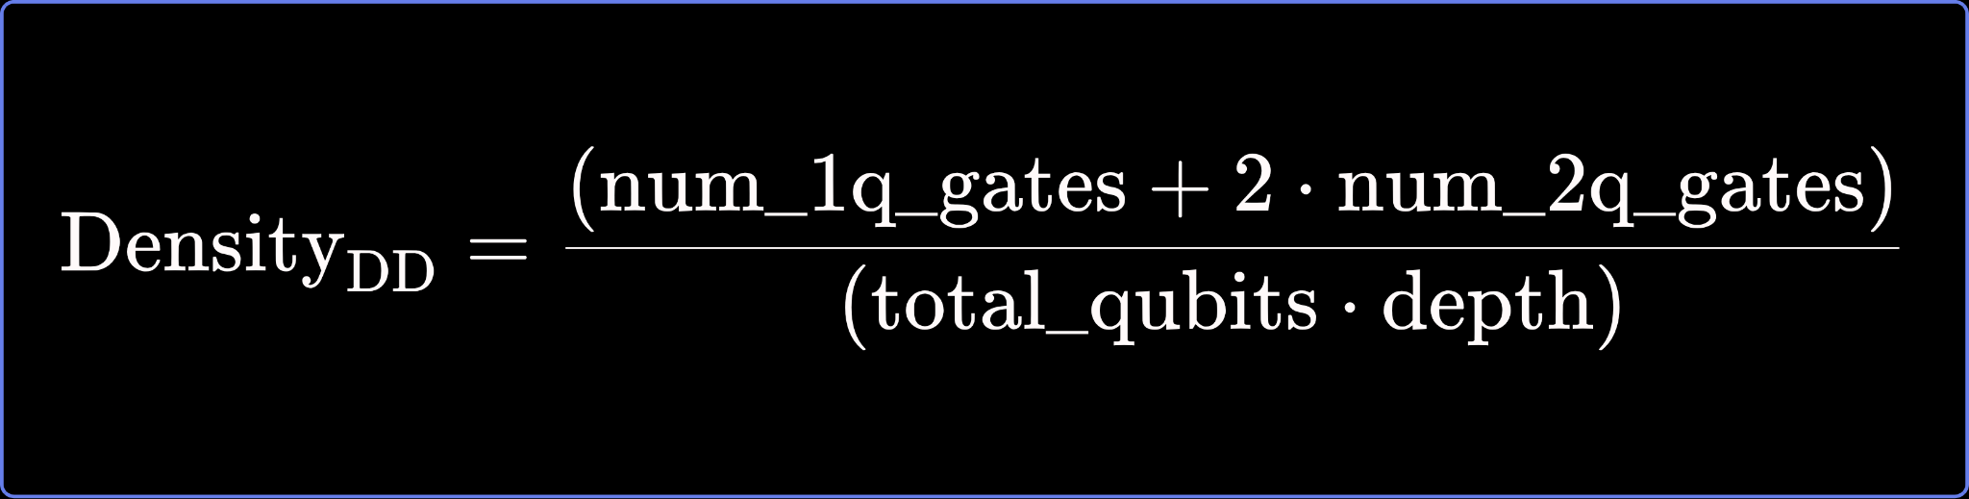
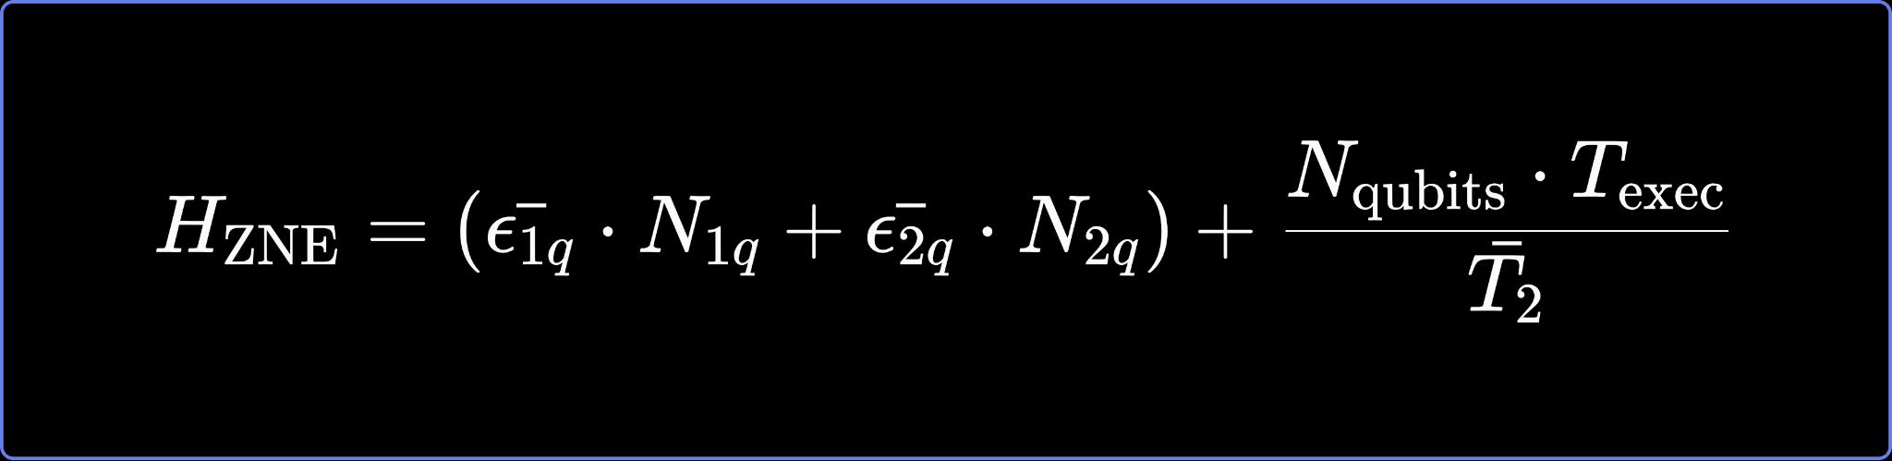
The Heuristics
Twirled Readout Error Extinction (TREX) READOUT_ERROR_THRESHOLD
Dynamical Decoupling (DD)
Zero-Noise Extrapolation (ZNE)
Notes:
Now let dive into the heuristics used.
In the three months we focused on the three error mitigation techniques. {List the EMST}
For TREX we simply defined a READOUT ERROR THRESHOLD.
For DD we calculate circuit density
For ZNE we calculate the overall noise sensitivity of the circuit.
We define the threshold values for these heuristics in config.py.

Slide 8
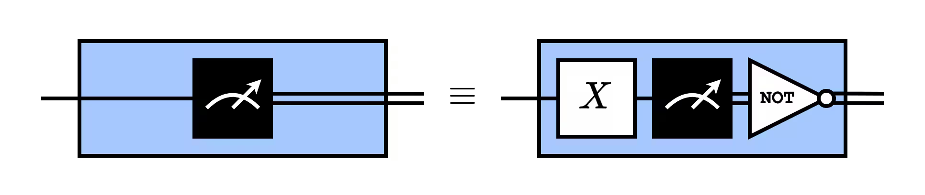
TREX
Mitigates Readout error.
Enable readout twirling if READOUT_ERROR_THRESHOLD ( 1% ) is exceeded for any active qubits in the circuit
Images Credits: IBM Quantum Platform
Notes:
For TREX we found the method shows performance when the max readout error for any qubit is greater than 1%.

Slide 9
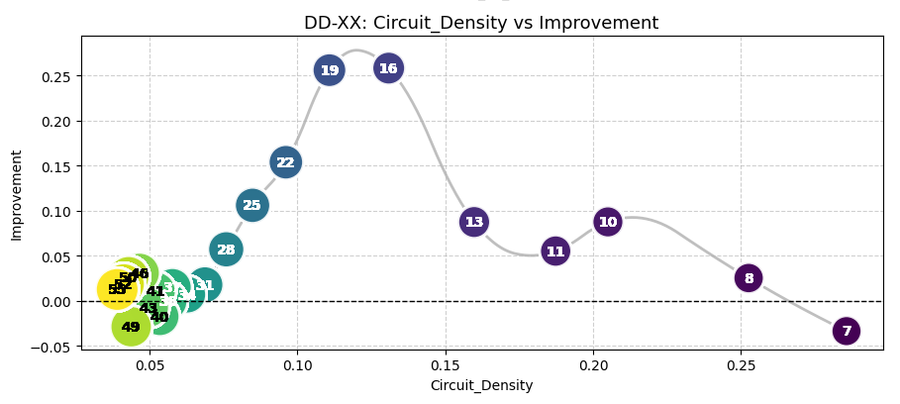
Dynamical Decoupling
Mitigates unwanted crosstalks between qubits during idle time.
Scheduling is important. We fix ALAP as the default scheduling method.
DD works best in low gate error regime with long idle times.
Notes:
For DD we knew

Slide 10
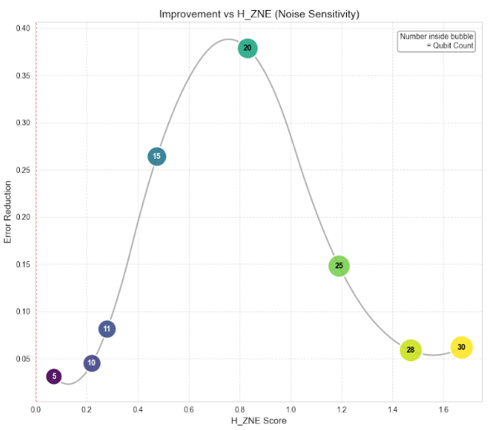
Zero-Noise Extrapolation
Mitigates noise through extrapolation of output (observable estimate) to zero noise.
Noise amplification through gate folding.

Slide 11
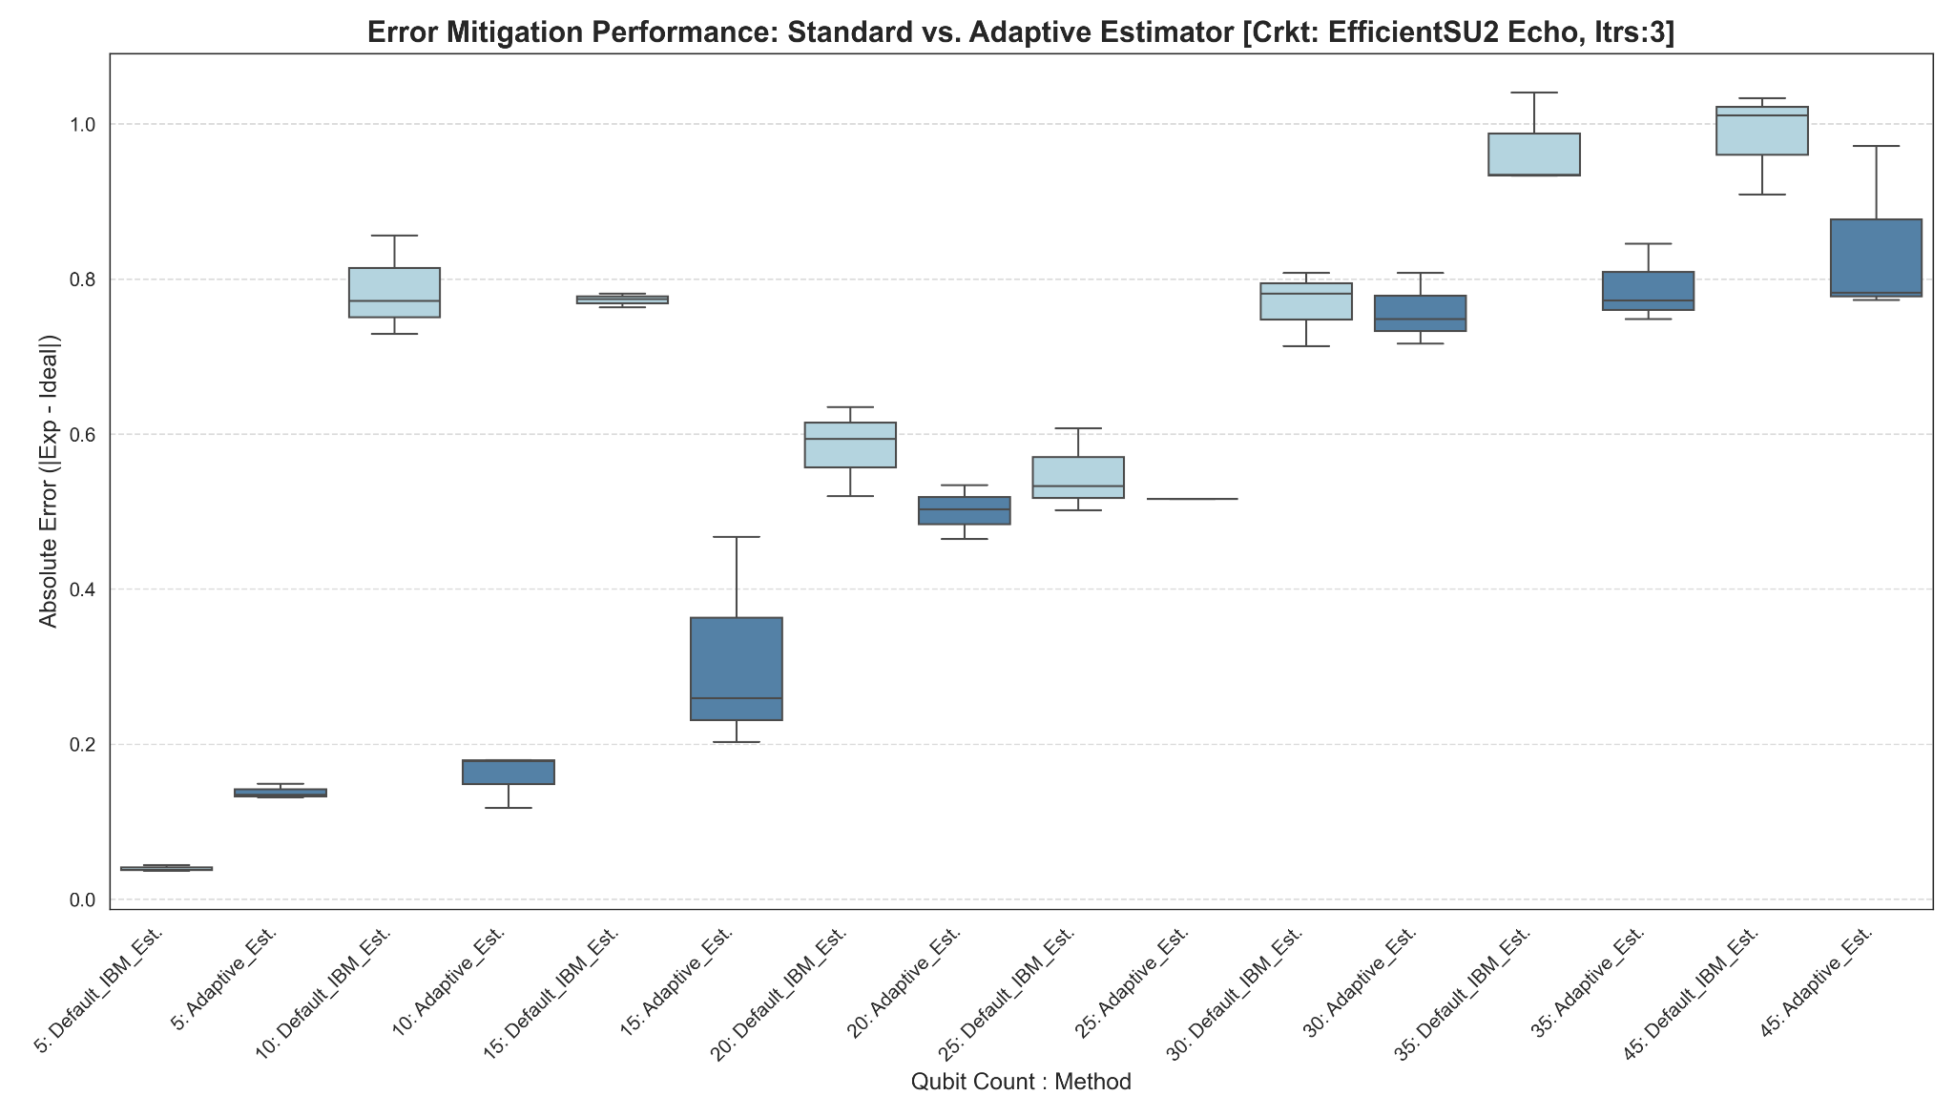
Results

Slide 12
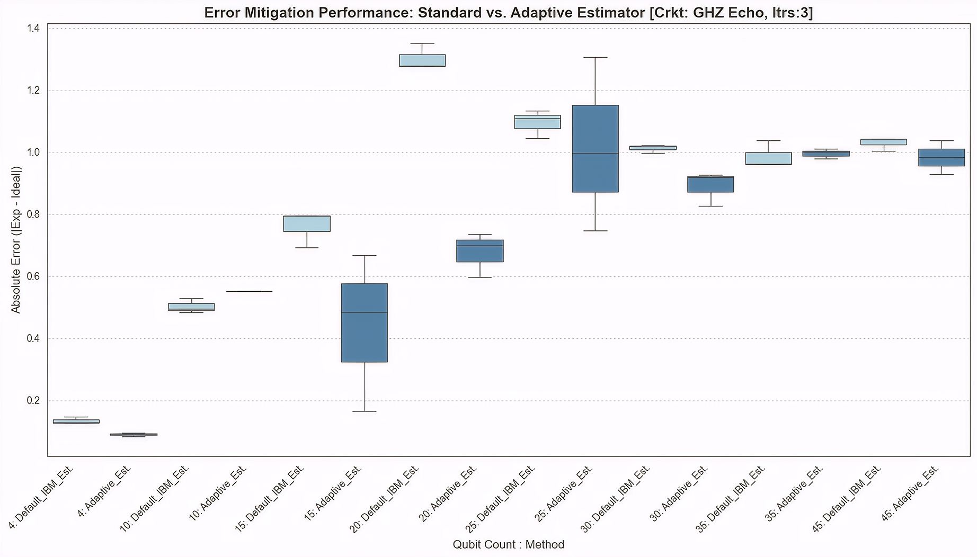
Results

Slide 13
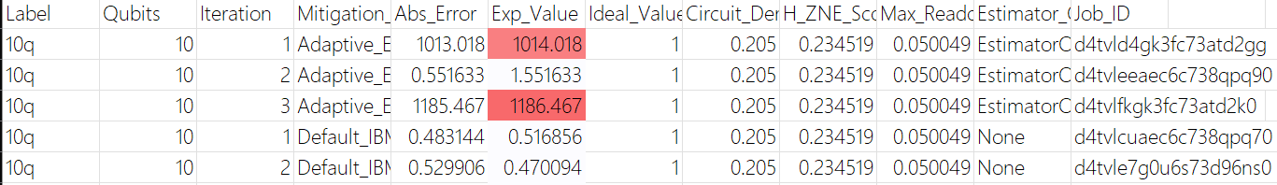
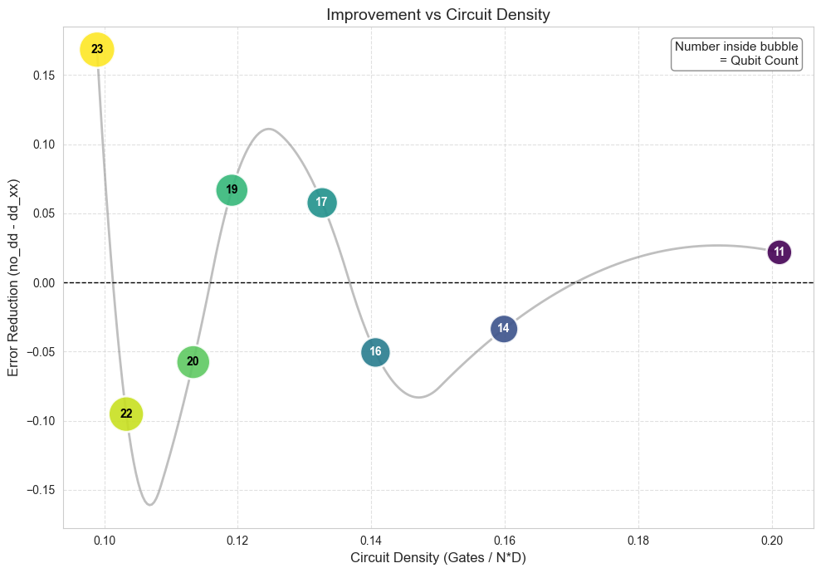
Challenges
Occurrence of unlikely large estimation values.
Oscillations in error for <Z^{⛒n} > wrt to ideal value for GHZ circuits.
The oscillations are primarily due to readout errors.

Slide 14
Future Scope
Refine the heuristics for the 50–100 qubit range.
Benchmarking over complex circuits.

Slide 15



Thank You
Special Mention :
Dikshant Dulal (Mentor), Founder at ISSAQ
IBM Quantum Support Team (Daito)
Aashay Pandharpatte
Knowledge Associate CDAC Pune
Kurian Uthuppu
Senior Project Manager
Tecnotree Corporation
Shreyansh Agarwal
Student BS Physics,
IIT Jodhpur

